Slide 1
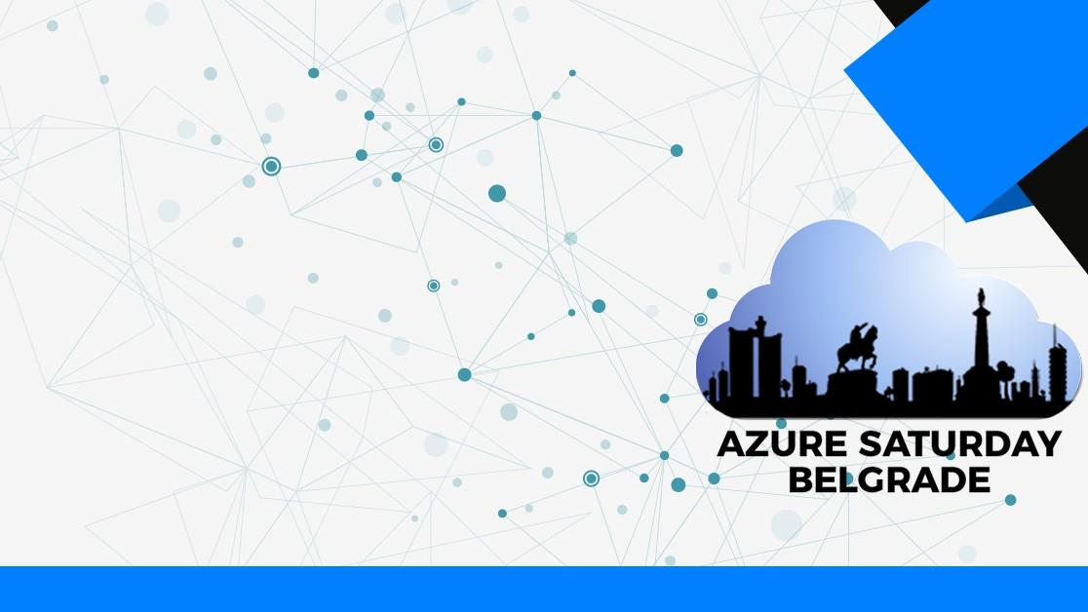
Six Horror Stories of Hybrid Identity Mismanagement
Sander Berkouwer

Slide 2
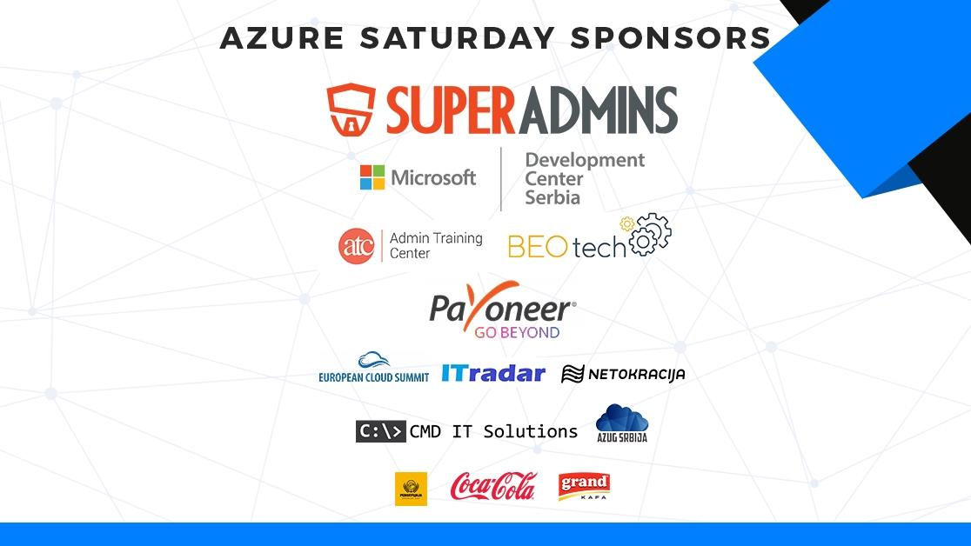

Slide 3
Agenda
What is Hybrid Identity anyway!?
The story of our GDPR Incompliance
The story of non-continuous integration
The story of going 300% over the project estimation
The story of the money-guzzling MFA Server
The story of the guest user in Azure Active Directory
The story of the passwordless Global Administrator

Slide 4

Hybrid Identity
Hybrid Identity is extending
On-premises Active Directory Domain Services
to
Microsoft’s Azure Active Directory service
Azure AD
Azure AD Connect
Active Directory
If done right, the benefits include:
Single Sign-on (SSO) to cloud apps
Conditional access and multi-factor authentication

Slide 5
What defines a person?
The story of our GDPR Incompliance

Slide 6

The story of…
An organization with multiple dissimilar applications and systems
Active Directory, but not many Active Directory-integrated apps
An existing synchronization engine to synchronize identities between Active Directory and apps
Synchronization
solution
Application
Application
Active Directory
3rd party
identity
01-04-1980--187265687

Slide 7
What we learned
In synchronization, the source anchor ties everything together end to end
Everyone in Active Directory and Azure AD can read all people’s properties (except passwords), by default
Using a social security number and a birth date is not the most brilliant way to define a source anchor
Yes, it does factor in changes to last name, first name and gender…
Using social security number cannot be used from a legal point of view if your organization resides or operates in the EU (GDPR)
Yes, you run the risk of getting fined.

Slide 8


Slide 9
Recommended Practices
Use the ObjectGUID as source anchor
Azure AD Connect does this *
Microsoft Identity Manager (MIM) does this
Alternatively: Base64-encode the source anchor
It’s sufficient to not make it human readable
Encoding does not equal encrypting…

Slide 10
How do you keep up to date?
The story of non-continuous integration

Slide 11
The story of…
The organization implemented Hybrid Identity in February 2018
The organization outsourced in May 2019
The organization had outsourced everything on-premises and kept full control in Microsoft 365
The outsourcer was responsible for ‘the legacy systems’
The organization used AD FS as their authentication method
The outsourcer patched Windows Server diligently *

Slide 12
What we learned
New versions of Azure AD Connect are introduced every 6 months
Current version is v1.4.38.0
Starting November 2020, Azure AD Connect versions are only supported for 18 months
Azure AD Connect features Automatic Upgrades
Automatic Upgrades are not available on unsupported configuration
AD FS was an unsupported configuration for Automatic Upgrades
Added to Azure AD Connect in version 1.3.20.0 (released April 2019)
Other unsupported configurations include:
Azure AD Connect running on Windows Server 2008 and Windows Server 2008 R2
Azure AD Connect running with a SQL Server (cluster) as its back-end

Slide 13
Question
What version of Azure AD Connect do you think this organization ran? (pick one)
Azure AD Connect v1.880.0 (released August 2018)
Azure AD Connect v1.3.20.0 (released April 2019)
Azure AD Connect v1.4.38.0 (current version)

Slide 14


Slide 15
Further considerations
Azure AD Connect v1.1.880.0 came with Health Agent v3.1.6
This agent’s service consumed 100% CPU
Organizations disabled it (August 2018)
The Azure AD Connect Health Service is responsible for the Automatic Upgrades functionality
We encounter a lot of organizations with Azure AD Connect v1.1.880.0
Azure AD Connect Health is an Azure AD Premium Feature
However, Azure AD Connect uploads information by default
Accessing the dashboard is behind Azure AD Premium P1

Slide 16
Recommended Practices
Migrate off Windows Server 2008 and Windows Server 2008 R2
Keep up to date with Windows Server updates
Keep up to date with Azure AD Connect
Enable Automatic Upgrades, or;
Configure a second Azure AD Connect in Staging Mode, and:
Disable Automatic Upgrades
Upgrade the Staging Mode Server to the latest version
Switch the Staging Mode Server with the actively synchronizing server
Switch back when running into problems
Note: You can only have one actively synchronizing Azure AD Connect per tenant, supportedly.

Slide 17
Can you give an estimate for implementing Hybrid Identity?
The story of going 300% over the project estimation

Slide 18
The story of…
The organization with an Active Directory domain named network.int
Their Windows Servers standardized on Windows Server 2008
Running a bunch of Linux servers and applications relying on the userPrincipalName for logging in
They wanted Hybrid Identity and the full functionality of Teams.
They wanted Pass-through Authentication and Password writeback
Pass-through authentication requires less resources compared to AD FS
Password writeback allows their employees to self-service reset their passwords.

Slide 19


Slide 20
What we learned
You want to run Azure AD Connect on Windows Server 2012 R2, or up
You need this version for Pass-through Authentication and Seamless Single Sign-on
Your Domain Controllers need to run Windows Server 2008 R2, or up
You need this version for Password Writeback (and for gMSAs when using AD FS)
You can use any of these three methods to configure Single Sign-on:
Register the AD domain name as public DNS domain name
.int is reserved for international treaty-based organizations and UN agencies
Change the userPrincipalName for each user object in scope
userPrincipalName is used extensively with Linux PAM and other applications
Use Alternative LoginID
Alternative LoginID is not fully supported for Microsoft Teams

Slide 21
Recommended Practices
Inventory your environment before you begin
Make plans to keep current in terms of:
Windows Server Operating Systems on Domain Controllers, AD FS servers, etc.
Active Directory Domain Functional Level (DFL)
Active Directory Forest Functional Level (FFL)
AD FS Farm Behavioral Level (FBL)
Azure AD Connect

Slide 22
What does it mean to enable a user in MFA Server?
The story of the money-guzzling MFA Server

Slide 23
The story of…
An international financial organization with 250K users worldwide
They had Office 365, but no Azure AD Premium licenses
They wanted Azure MFA Server (back in 2016)
They wanted a staged roll-out per country

Slide 24
What we learned
When you put a user in scope of Azure MFA Server
It gets synchronized to the Azure MFA Server configuration
It gets enabled by default
When you enable a user in MFA Server
It attaches to an Azure AD Premium license, or
It assigns an Azure MFA license *

Slide 25


Slide 26
Recommendations
Azure MFA Server is in the process of getting deprecated
Target Azure MFA (the service) for your organization’s MFA needs
Configure Azure MFA for cloud services
through Security Defaults: free for all when using Microsoft Authentication App
Through Conditional Acess requires Azure AD Premium licenses
Configure Azure MFA for on-premises systems, applications and services
Through AD FS on Windows Server 2016 built-in
Through the Azure MFA NPS Extension for RADIUS-based applications
Note: When you put a person’s account in scope of Azure MFA, they are required to register MFA once, within 14 days

Slide 27
What’s a guest anyway?
The story of the guest user in Azure Active Directory

Slide 28
The story of…
An organization relied on Azure AD for access to most of its applications, systems and services
The organization used default settings
The organization hooked their financial application to Azure AD
They wanted a review of their settings

Slide 29
What we learned
Conditional Access to the financial application was set for All users
All users includes guests
By default, everyone can invite guests, including guests
A member had invited its personal address as a guest
Through the guest account, he had gained access to the financial application,
Through the guest account, he issued additional invoices for services
Through its member account, he approved the invoices (only check in place was that no person could approve self-issued invoices)

Slide 30
“We’re completely secure.”
The story of the passwordless Global Administrator

Slide 31
The story of…
An organization was using Microsoft Cloud for everything
The organization had implemented Privileged Identity Management
All admins had to get approval to access their Global Admin privileges
One account was excempt from PIM
It has Global Admin privileges, adhering to Microsoft’s recommended practice for fallback accounts
This account’s 32-character password was printed and split between two vaults
This account was the only account excempt from performing multi-factor authentication to access the Azure Portal app
This account’s main sign-in method was a FIDO 2 key, stored in one of the vaults

Slide 32


Slide 33
What we learned
This organization checked all of Microsoft’s recommended boxes:
Enable Multi-factor Authentication (MFA) for all users
Separate day-to-day accounts from privileged accounts
Enable Azure AD Privileged Identity Management requires Azure AD Premium P2
Create a fall-back admin account (for when Azure MFA fails)
Periodically review people in privileged roles
Vaults are fire-resistent for a certain amount of time, not fire-proof

Slide 34
Concluding

Slide 35
Just three things:
Keep current
‘Fire and Forget’ and ‘Deploy and write off in 4 years’ no longer work
Implement MFA
If you’re on MFA Server, migrate to Azure MFA
If you’re manually enabling MFA, migrate to Conditional Access
Following Microsoft’s recommended practices is not all
Think about your Identity Single Points of Failure (SPoFs), and mitigate them

Slide 36
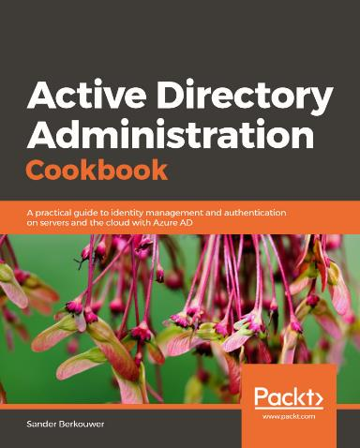
Thank you!
DirTeam.com
ServerCore.net
@SanderBerkouwer
www.linkedin.com/in/ sanderberkouwer
https://www.youtube.com/channel/ UC513MRJceXlr4P3sMIrcF9w

